Slide 1

FORMATING OF TABLES IN EXCEL
BY JULIANA NNAJI

Slide 2
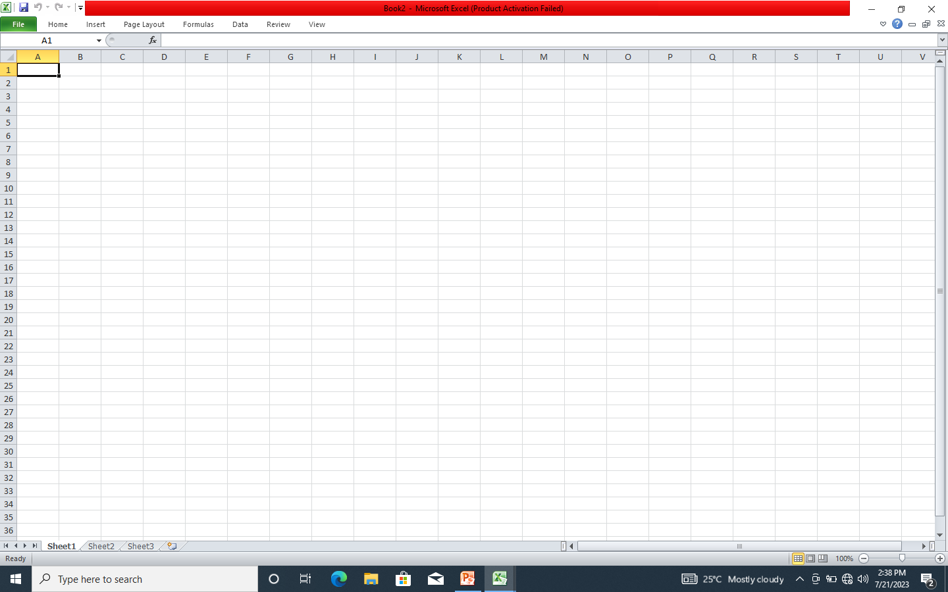
STEP 1. GO TO EXCEL

Slide 3

STEP 2. FILL IN THE ROWS & COLUMNS

Slide 4
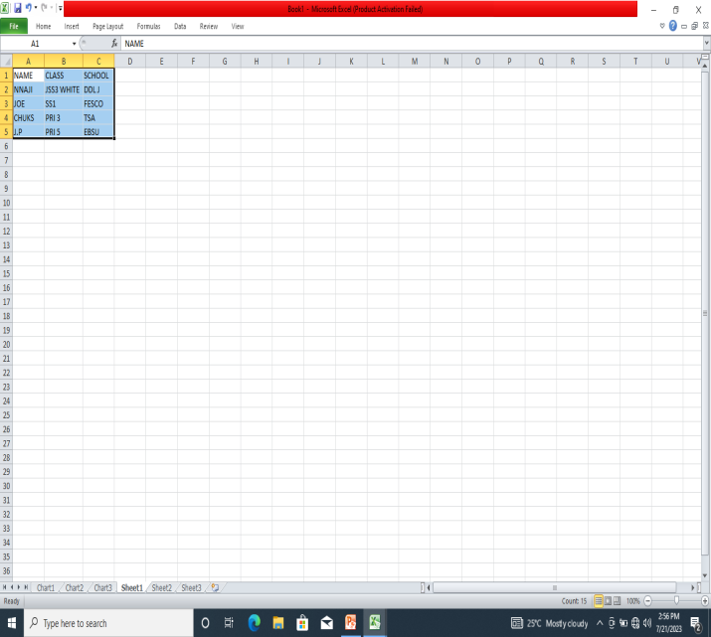
STEP 3. HIGHLIGHT THE REQUIRED ROWS & COLUMNS

Slide 5
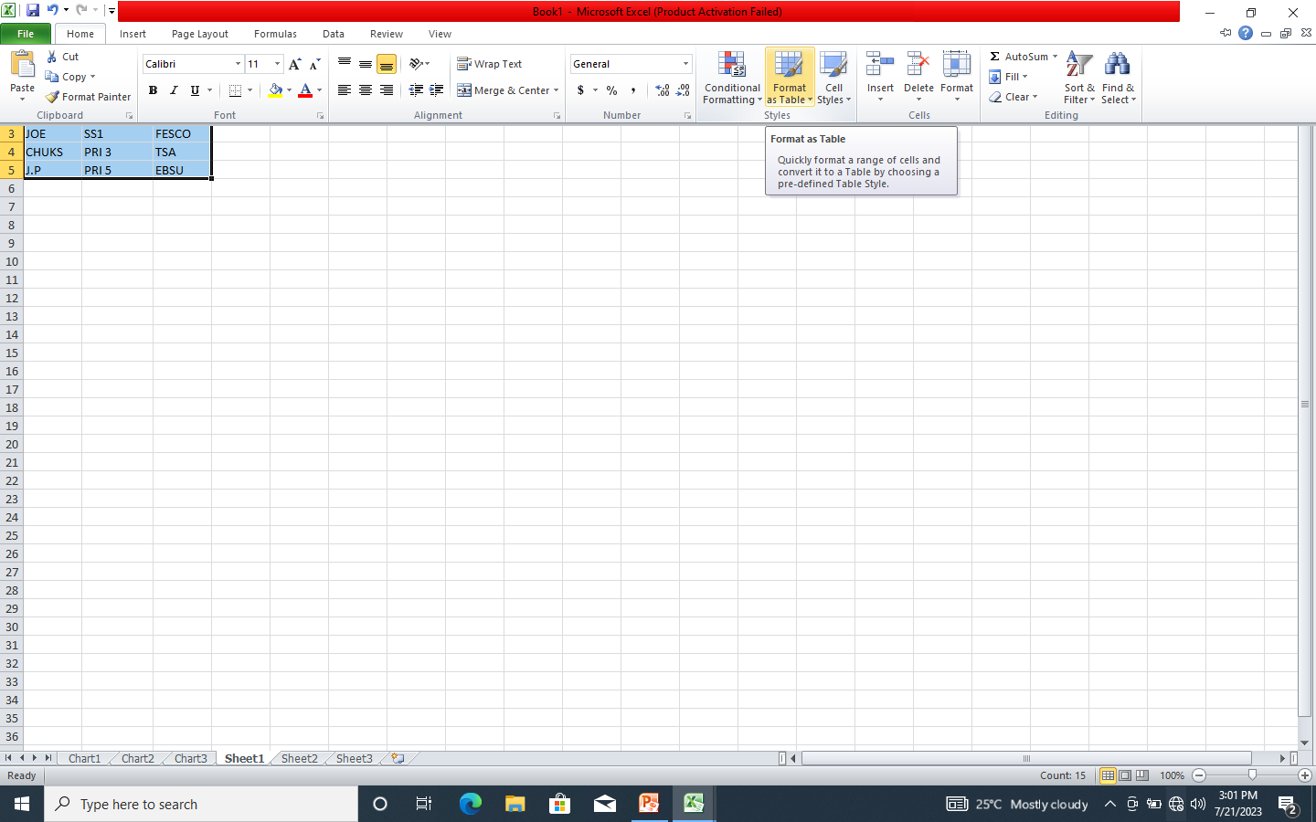
STEP 4. GO TO FORMAT AS TABLE

Slide 6
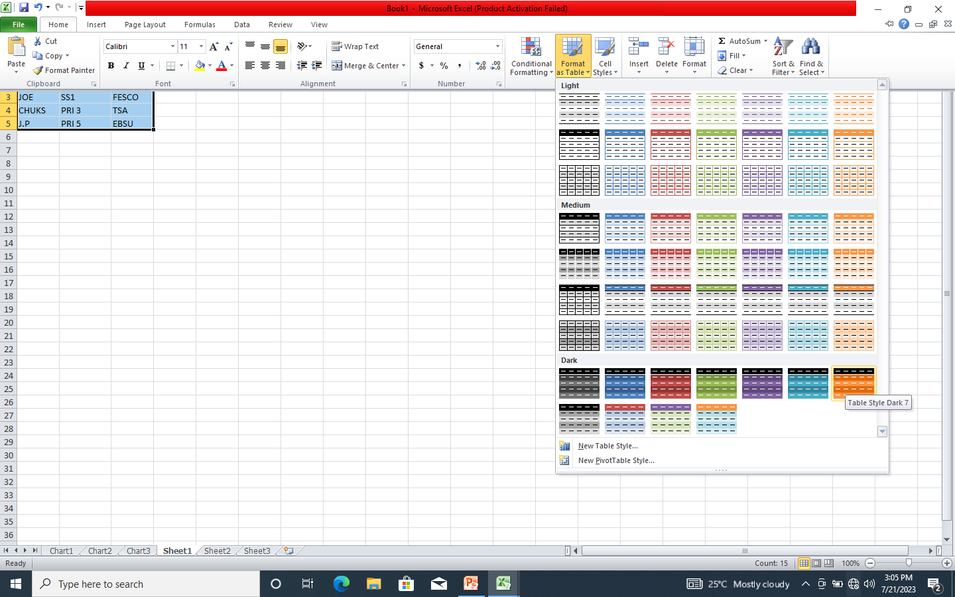
STEP 5. CHOSE PREFERRED TABLE

Slide 7
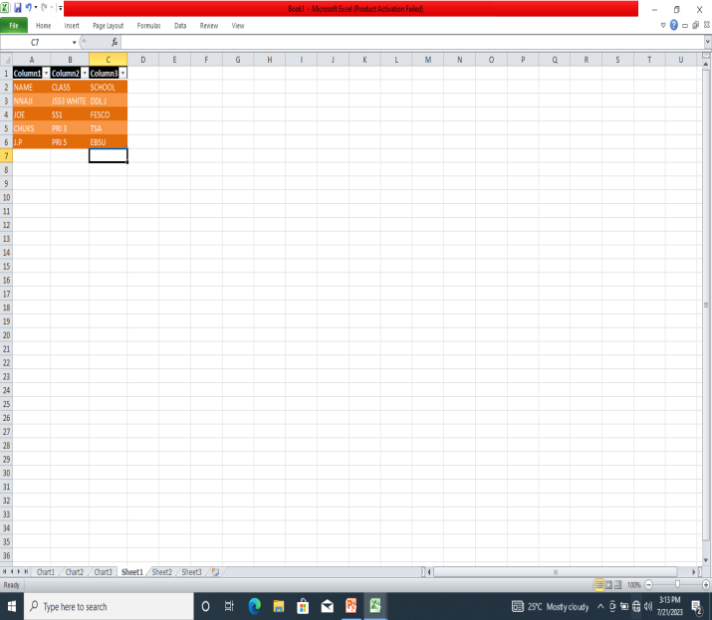
YOUR FORMATED TABLE IS READY

Slide 8
CELL STYLING IN EXCEL
BY NNAJI JULIANA

Slide 9

STEP 1. GO TO EXCEL

Slide 10

STEP 2. FILL IN THE ROWS & COLUMNS

Slide 11

STEP 3. HIGHLIGHT ROWS & COLUMNS

Slide 12
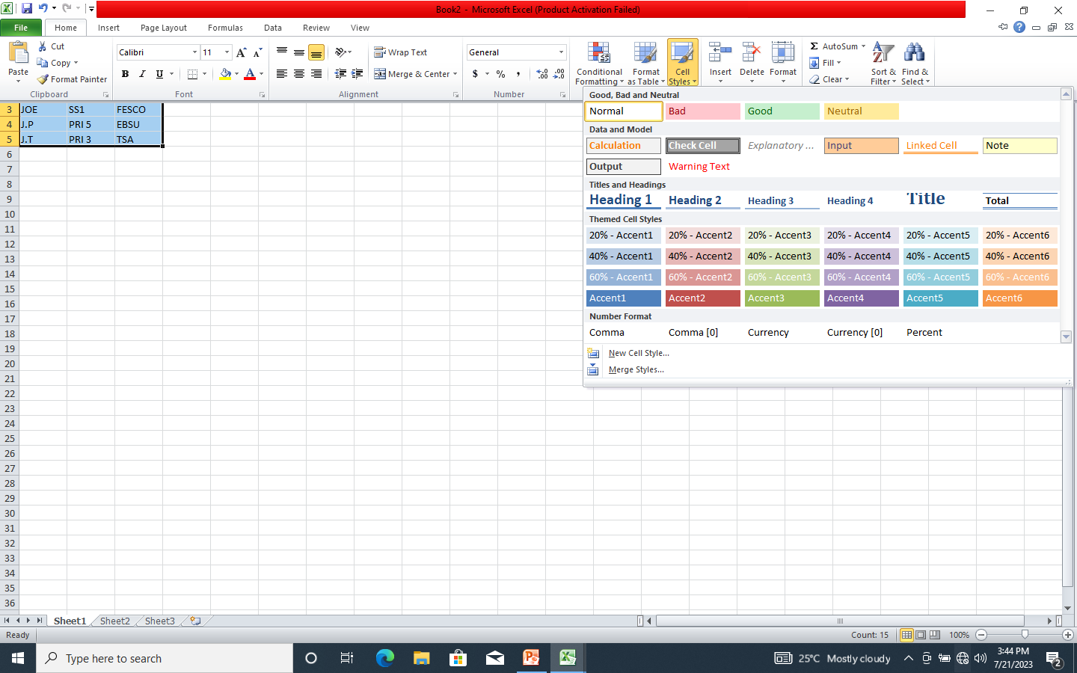
STEP 4. GO TO CELL STYLES

Slide 13
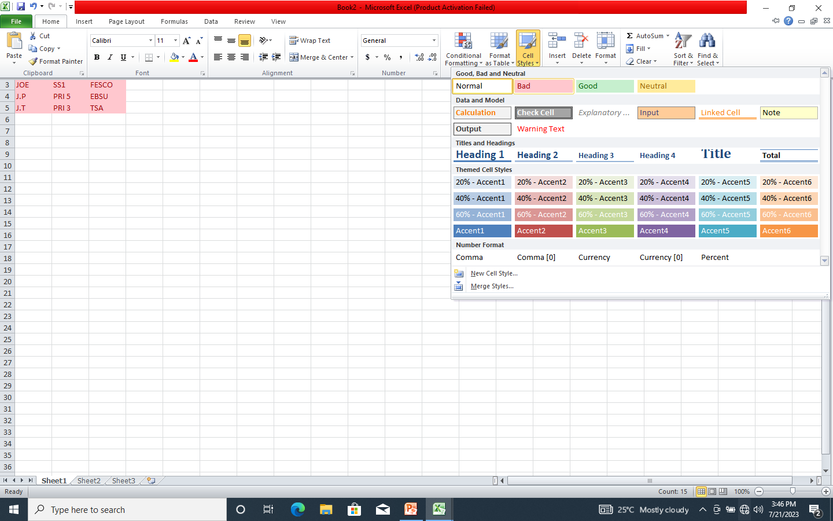
STEP 5. SELECT PREFFERRED CELL STYLE

Slide 14
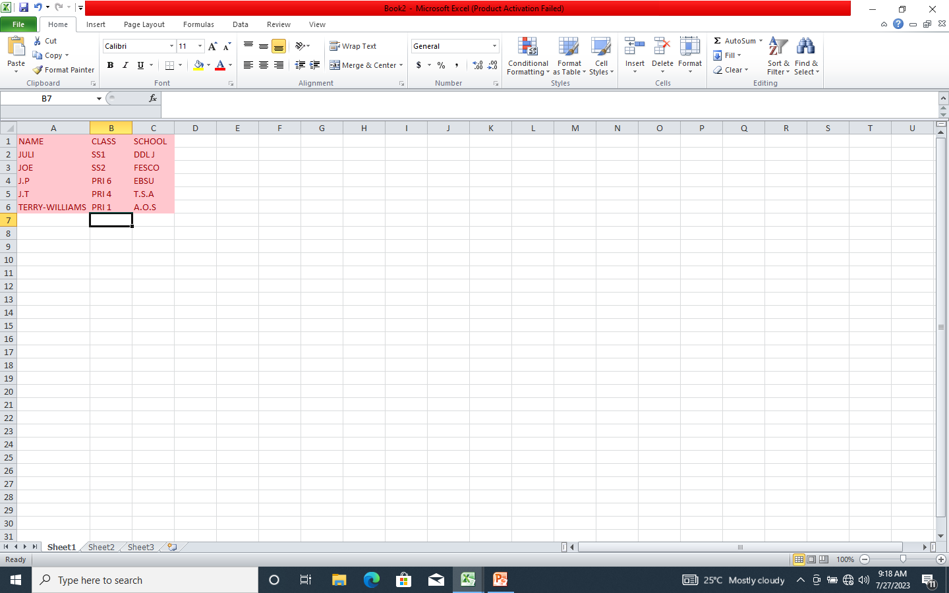
YOUR STYLED CELL IS READY

Slide 15
CELL FORMATING IN EXCEL
BY NNAJI JULIANA

Slide 16
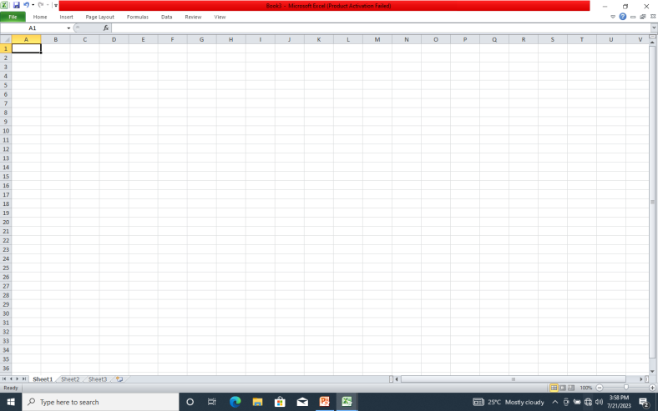
STEP 1. GO TO EXCEL

Slide 17
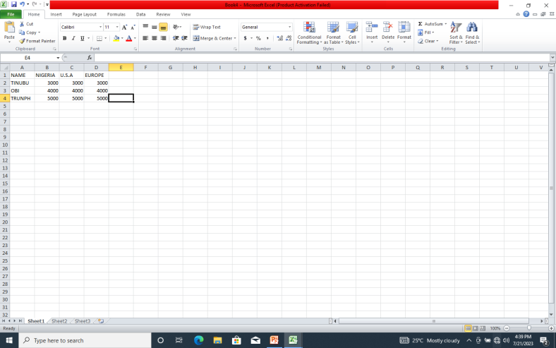
STEP 2. FILL IN THE REQUIRED ROWS & COLUMNS

Slide 18
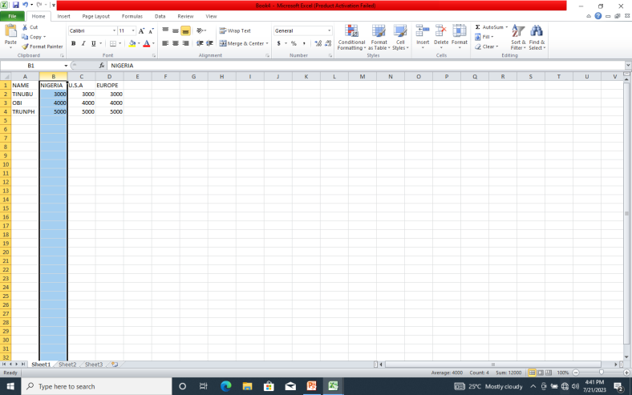
STEP 3. SELECT REQUIRED CELL

Slide 19
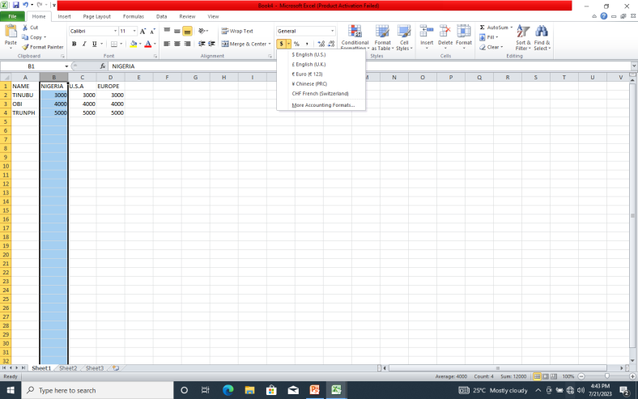
STEP 4. GO UNDER GENERAL YOU WILL SEE A CURRENCY SYMBOL CLICK IT

Slide 20
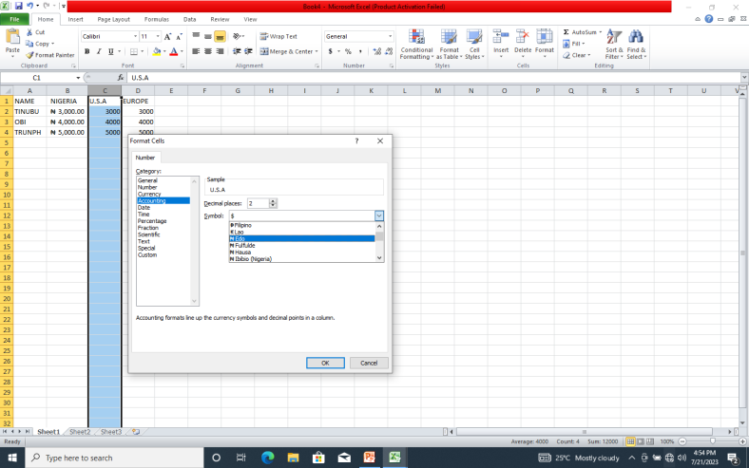
STEP 4. SELECT CURRENCY OR FORMULAR OF CHOICE IF CURRENCY OR FORMULAR NEEDED IS’NT THERE ,CLICK MORE ACCOUNTING FORMULARS GO TO SYMBOLS CLICK THE ARROW SCROW DOWN SELECT REQUIRED ONE.

Slide 21
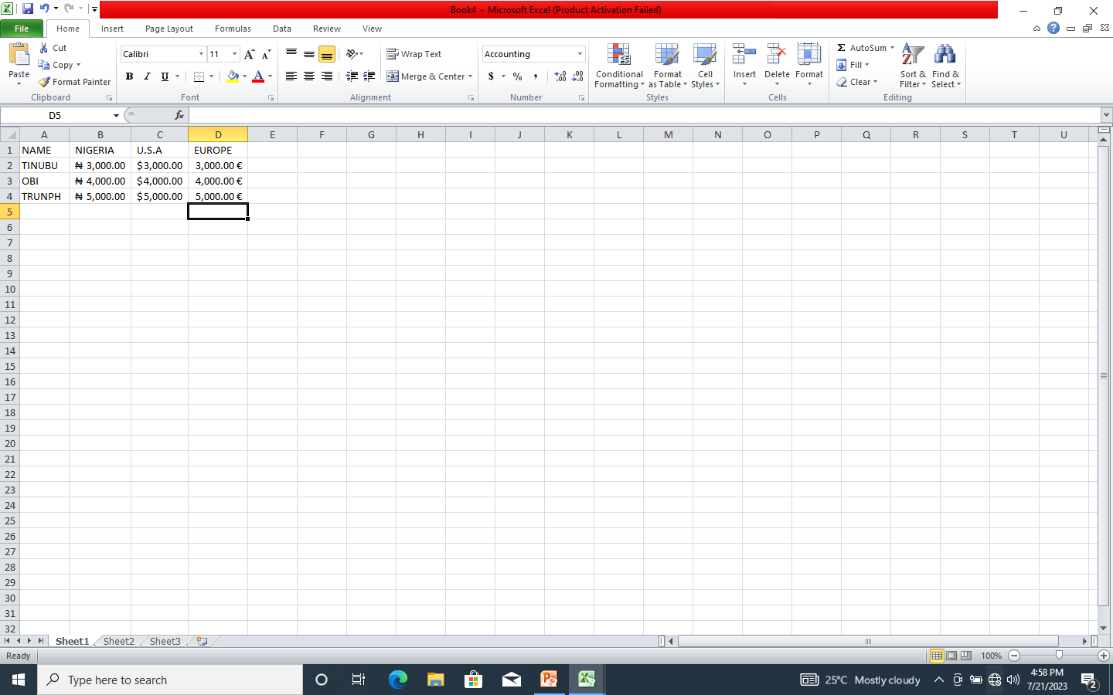
NOW YOU HAVE YOUR FORMATED CELL

Slide 22
TOPICS DISCUSSED
FORMATING TABLES
CELL STYLING
&
CELL FORMATING
BY JULIANA NNAJI

